Slide 1

Outlier Removal: the Z-Score and IQR Method
Professor Bo Liu
James Watt School of Engineering

Slide 2
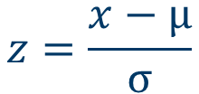
The Z-score method
x: data point
μ: mean
σ: standard deviation
z: z-score
$$z=\frac{x−μ}{σ}$$
outlier
The z-score tells how many standard deviation the data point is away from the mean.
The further the data point is away from the mean, the more likely the data point is an outlier.
See live script

Slide 3
The Z-score method
outlier
% Filtering out those samples having large z-scores
i_mem = []; % the indexes of which will be removed
for i = 1:size(z, 1)
if z(i) >= 1 % the threshold could also be 2, depends on different situations
i_mem = [i_mem, i];
end
end
X(i_mem) = []; % Removing outliers
histogram(X)
See live script

Slide 4
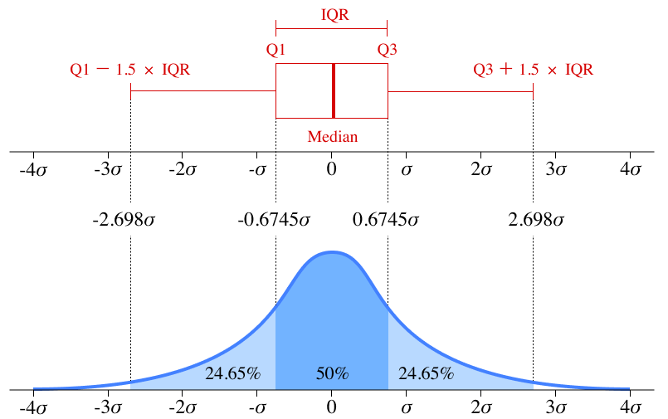

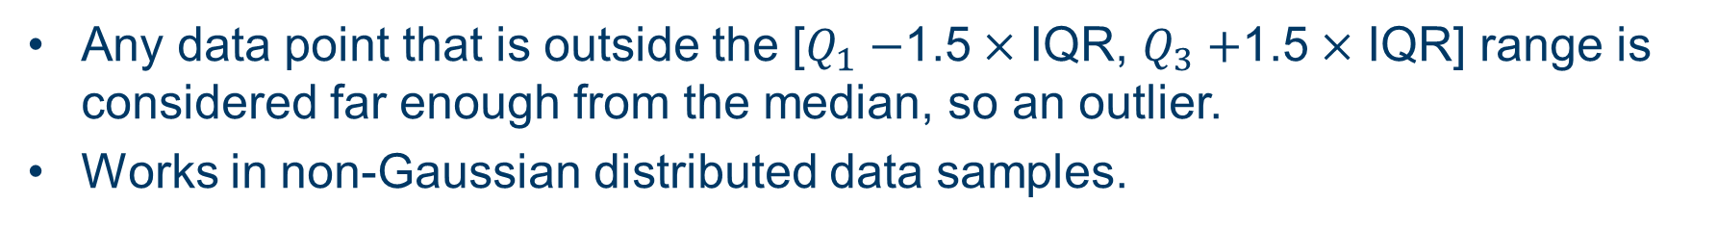


The interquartile range (IQR) method
$$IQR=Q_{3}−Q_{1}$$
$Q_{1}$: 25-th percentile
$Q_{3}:$ 75-th percentile
Any data point that is outside the [$Q_{1}−$1.5$×$ IQR, $Q_{3}+$1.5$×$ IQR] range is considered far enough from the median, so an outlier.
Works in non-Gaussian distributed data samples.
See live script

Slide 5
The interquartile range (IQR) method
outlier
% Filtering out those samples lies outside the IQR
Q1 = prctile(X,25);
Q3 = prctile(X,75);
IQR = Q3 - Q1;
i_mem = []; % the indexes of which will be removed
for i = 1:size(X, 1)
if X(i) >= Q3 + 1.5*IQR || X(i) <= Q1 - 1.5*IQR
i_mem = [i_mem, i];
end
end
X(i_mem) = []; % Removing outliers
histogram(X)
See live script

Slide 6




Thanks!
#UofGWorldChangers
@UofGlasgow

